Slide 1
jQuery Mobile
Lesson 05 : Working with List Views
Notes:
Add instructor notes here.

Slide 2
Lesson Objectives
In this lesson, you will learn :
Overview of list views
Basic list views
Advanced list views
Notes:
Add instructor notes here.

Slide 3
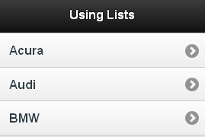
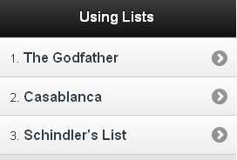
5.1 : Overview of list views List basics
A listview is coded as a simple unordered list containing linked list items with a data-role="listview" attribute.
<ul data-role="listview“ >
<li><a href="acura.html">Acura</a></li>
<li><a href="audi.html">Audi</a></li>
<li><a href="bmw.html">BMW</a></li>
</ul>
<ol data-role="listview">
<li><a href="index.html">The Godfather</a></li>
<li><a href="index.html">Casablanca</a></li>
<li><a href="index.html">Schindler's List </a></li>
</ol>
Notes:
Everybody needs lists of data within their web applications. A list is one of the most common user interface controls used. Lists may be simply a list of entries (like contact names), tabular in form (a grid), or even appear collapsed and respond to user input (combo box).
The jQuery Mobile framework thus provides a set of list types, each of which is best suited to certain situations and applications: we can have numbered lists, nested lists, lists with icons, thumbnails, and many other improvements, and user-friendly options that enhance the usability of list view elements.
JQuery Mobile supports a list by using the listview widget. A list is defined by an ordered or unordered list applying the data-role="listview" attribute. Eg:
<ul data-role="listview">
<li>Item</li>
<li>Item</li>
<li>Item</li>
</ul>
Each list item (Li tag) is an entry in the list, and can contain a variety of markup contents. For example, a list may have an H3 element to represent the list item's header. Also, a list can display additional content by using a paragraph tag (P). Alternatively, a list can solely be a hyperlink directing the user to another view or page.
By default, tapping or swiping on list view elements has no effect. Such lists are called read-only lists. To convert the list items as tappable buttons, include anchor tags in the list item markup as shown in the next example and on the slide above.
<ul data-role="listview">
<li><a href="#">Item</a></li>
</ul>
jQuery Mobile applies its scripting to mobile devices which are known to support it and render the page correctly. Other browsers will fall back to a standard display as if jQuery Mobile was not used at all.
As jQuery Mobile makes use of a single-page navigation model (which
allows for multiple pages to be present at the same time in the DOM)
we must make sure all of our forms (and form elements as well) have a
different form ID to prevent any kind of trouble.

Slide 4
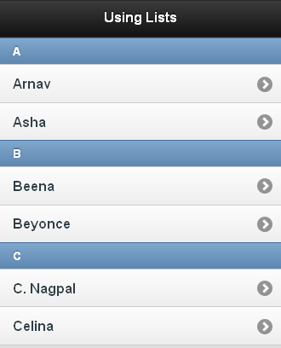
5.2 : Basic list views List View Dividers
To divide lists by section headers, apply the data-role="list-divider" to any list item you identify as a divider
<ul data-role="listview">
<li data-role="list-divider">A</li>
<li><a href="#">Arnav</a></li>
<li><a href="#">Asha</a></li>
<li data-role="list-divider">B</li>
<li><a href="#">Beena</a></li>
<li><a href="#">Beyonce</a></li>
...
</ul>
Notes:
List items can be turned into dividers to organize and group the list items. This is done by adding the data-role="list-divider" to any list item.

Slide 5
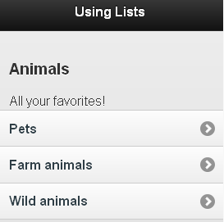
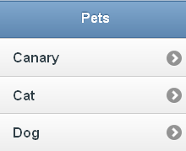
5.2 : Basic list views Nested Lists
List view widget supports nesting of lists. Nested lists can be created by nesting child ul or ol inside list items.
<h3>Animals</h3>
<p>All your favorites !</p>
<ul data-role="listview">
<li>Pets
<ul>
<li><a href="index.html">Canary</a></li>
<li><a href="index.html">Cat</a></li>
<li><a href="index.html">Dog</a></li>
....
</ul>
</li>
<li>Farm animals
<ul> ...
Notes:
By nesting child ul or ol inside list items, you can create nested lists. When a list item with a child list is clicked, the framework will show a new page populated with the title of the parent in the header and the list of child elements.

Slide 6
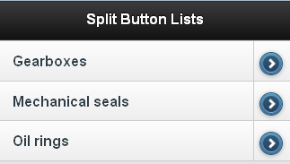
5.3 : Advanced list views Split Button Lists
Split button lists allow users to perform more than one action on the same list item.
A split button is used to offer two independently clickable items; the main content of the list, and an icon to the right of the list displaying an icon that triggers some functionality.
To create a split list item, simply add a second link to the list item; jQuery Mobile adds a vertical line to separate the two buttons.
<ul data-role="listview">
<li>
<a href="#">Gearboxes</a>
<a href="purchase.html">Buy </a>
</li>
<li>
<a href="#">Mechanical seals</a>
<a href="purchase.html">Buy </a>
</li>
... </ul>
Notes:
To make a split list item, simply add a second link inside the li and the framework will add a vertical divider line, style the link as an icon-only arrow button, and set the title attribute of the link to the text of the link for accessibility.
You can set the icon for the right split icon by specifying a data-split-icon attribute on the listview with any icon name you want. The default icon is "arrow-r“. By adding a data-icon attribute to the list item, you can set individual icons for each split.

Slide 7
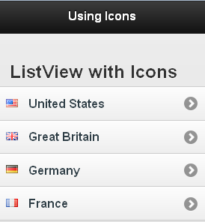
5.3 : Advanced list views Thumbnails & icons
To add thumbnails to the left of a list item, simply add an image inside a list item as the first child element.
<ul data-role="listview">
<li><a href="#"><img src=‘us.png' class='ui-li-icon'/>
United States </a></li>
<li><a href="#"><img src=‘gb.png' class='ui-li-icon'/>
Great Britain </a></li>
<li><a href="#"><img src=‘de.png' class='ui-li-icon'/>
Germany </a></li>
<li><a href="#"><img src=‘gf.png' class='ui-li-icon'/>
France</a></li>
</ul>
Notes:
To add thumbnails to the left of a list item, simply add an image inside a list item as the first child element. The framework will scale the image to 80 pixels square. To use standard 16x16 pixel icons in list items, add the class of ui-li-icon to the image element.
Thumbnails are images that are normally displayed flush with the left of the list item, while icons are smaller and are normally vertically centered in the list item.

Slide 8
Demo
BasicListview.html
ListviewDivider.html
ListviewFilter.html
ListviewIcons.html
ListviewRich.html
NestedList.html
SplitButtons.html
Notes:
Code for these demos has been discussed in the earlier slides.
Pls. see the demos in lesson-5 folder.
Add instructor notes here.

Slide 9
Lab
Lab Topic
Notes:
Add the notes here.
Add instructor notes here.

Slide 10
Summary
In this lesson, you learnt:
Overview of list views
Basic list views
Advanced list views
Notes:
Add the notes here.
Add instructor notes here.

Slide 11
Review Question
Question 1 : In Split button list, you can set the icon for the right split icon by specifying a _____ attribute on the listview
Option 1 : data-icon
Option 2 : data-splitbutton-icon
Option 3 : data-split-icon
Question 2 : By default, tapping or swiping on list view elements has no effect
True/False
Question 3: To divide lists by section headers, apply the ____to any list item you identify as a divider
Option 1 : data-role="listview"
Option 2 : data-role="list-divider"
Option 3 : data-role=“list-separator"
Notes:
Add the notes here.
Add instructor notes here.
Answer 1 : option 3
Answer 2 : true
Answer 3 : option 2

